Slide 1
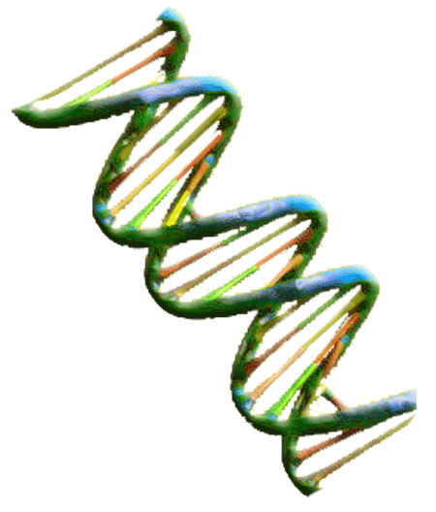
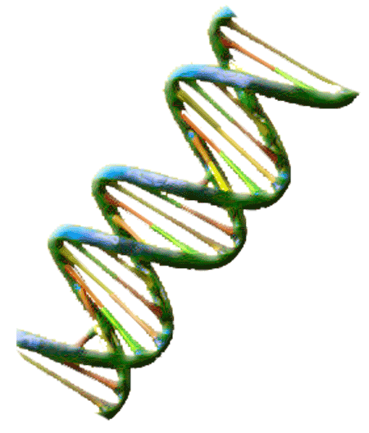
Bos Taurus
Genetics
Exploring Genotypes and Phenotypes of Longhorn Cattle
Base Color

Slide 2
Genetics Vocabulary
Phenotype – describes the physical appearance of a specific genetic trait or characteristic
Genotype – the genetic code consisting of a pair of alleles that describes a inheritable characteristic or trait
Gene- a unit of inheritable information arranged located within chromosomes
Allele – one member of a pair of genes that determines genetic characteristics
Wild-type Allele – the gene or characteristic that most commonly occurs in the natural environment this allele is commonly identified as wild by a + symbol following it’s letter designation.
Heterozygous - a pair of alleles that contain two different alleles one of which is dominant
Homozygous – a pair of identical alleles
Dominant Trait – a trait that will appear in offspring if one allele is present . This trait will appear in both heterozygous and homozygous gene pairs.
Recessive Trait – a trait that will appear only if two copies of the allele are present. This trait only appears in homozygous gene pairs

Slide 3
Color Genetics
All color in cattle is the result of two pigments black and red.
    Black can look brown in lower concentrations.
    Red can appear orange or yellow.
    White areas are a result of lack of both pigments.
Three alleles control the amount of pigments in cattle E_{D}, E+ and e
The E_{D} allele produces black pigment.
The E+ allele is called the wild-type allele and produces both red and black pigments. Calves are red at birth and turn dark brown or gray as they mature, usually with a light muzzle.
The e allele produces red pigment.
The wild-type allele is thought to represent the ancestral coloration of the wild Aurochs, from which modern Bos taurus cattle breeds have descended.

Slide 4
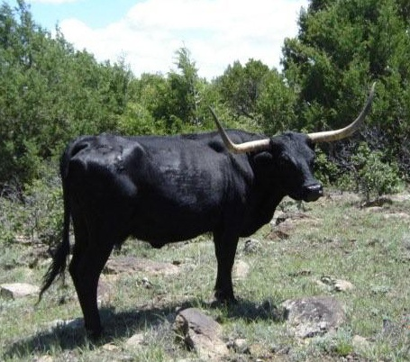
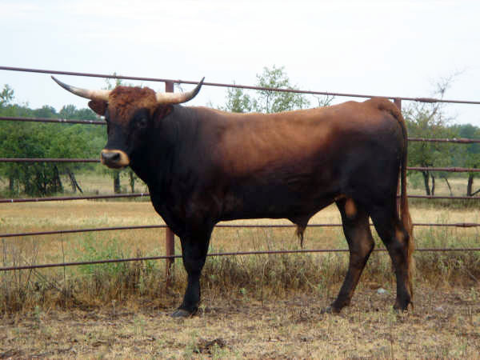
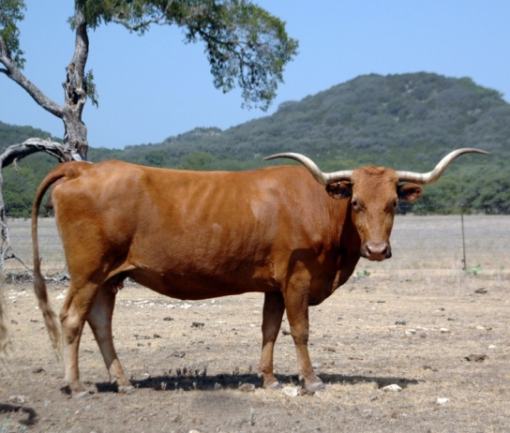
Homozygous Base Color Genotypes
Black Dark Brown or Gray Red
E_{D}/E_{D} E+/E+ (wild allele) e/e
The black allele is dominant over both wild and red alleles .
The wild allele is dominant over the red allele.
(E_{D} > E+ > e)
1. Three Alleles make the base color genetics more complex list all possible genotypes under their phenotypes. Possible Allele Combinations: E_{D} E_{D}, E+ E+, e e, E_{D} E+, E_{D} e , E+ e

Slide 5
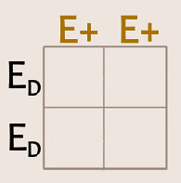
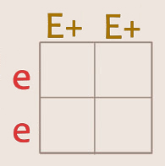
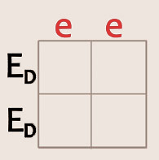
Homozygous Base Color Cross
2. Fill out the Punnett Squares for all possible homozygous color crosses.
How do the percentages in genotype results compare with phenotype results in homozygous crosses?

Slide 6
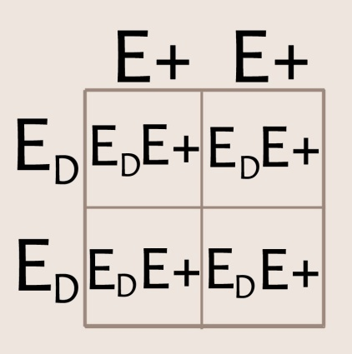
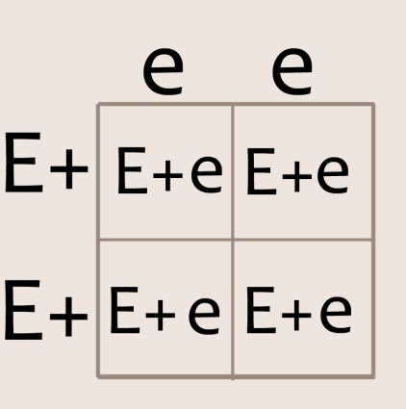
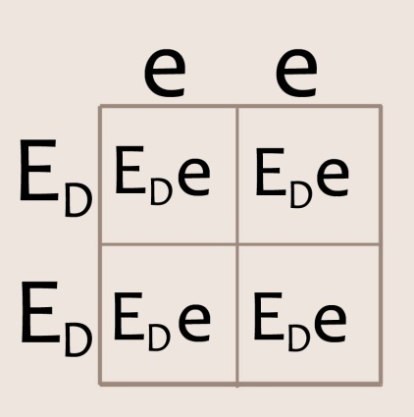
Homozygous Base Color Cross Results
Black Allele X Wild Type Allele Wild Type Allele X Red Allele Black Allele X Red Allele
Genotype: 100% E_{D}/E+
Phenotype: 100% Black
Genotype: 100 % E+/e
Phenotype: 100 % Dark Reddish Brown or Reddish Gray
Genotype: 100 % E_{D}/e
Phenotype: 100 % Black

Slide 7
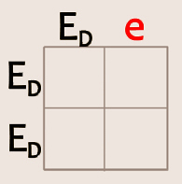
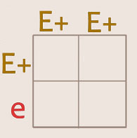
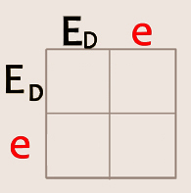
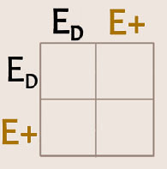
Two Allele Heterozygous Genetic Crosses
Now try the following heterozygous crosses:
3. Two Alleles
Homozygous X Heterozygous
4. Same Genotypes
Heterozygous X Heterozygous
(E_{D} > E+ > e)
List all possible phenotypes and genotypes and their percentages for each cross.

Slide 8
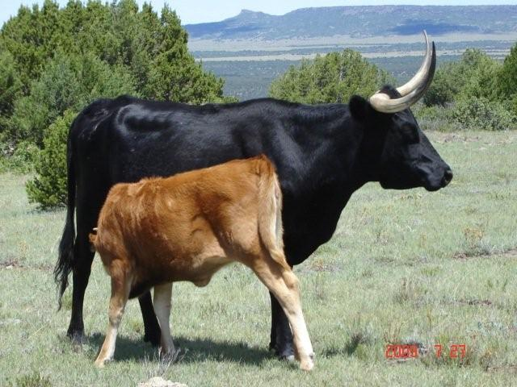
5. Based on what you just learned which statement below is true?
a. The cow and calf are both homozygous.
b. The calf inherited her color genes from her sire.
c. The cow is heterozygous and the calf inherited her
recessive gene.
d. This cow could not be this calf’s dam.

Slide 9
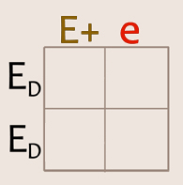
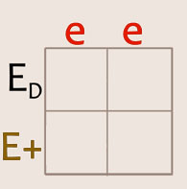
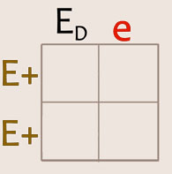
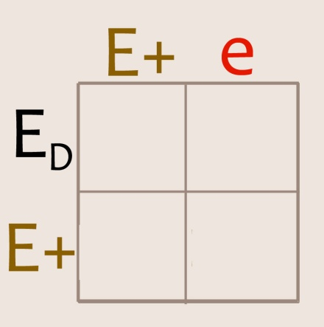
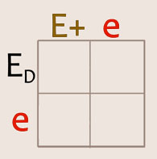
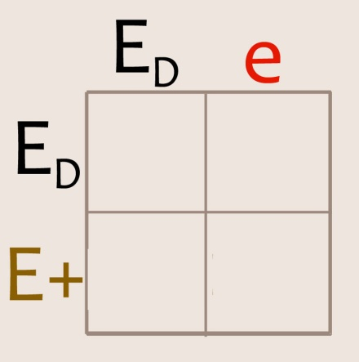
Three Allele Heterozygous Crosses
Now try working three allele Punnet squares.
6.
Three Alleles
Homozygous
X
Heterozygous
7.
Different Genotypes
Heterozygous
X
Heterozygous

Slide 10
TEKS
Middle School Science, Grade 7 112.19.b
(14) Organisms and environments. The student knows that reproduction is a characteristic of living organisms and that the instructions for traits are governed in the genetic material. The student is expected to:
(A) define heredity as the passage of genetic instructions from one generation to the next generation;
(B) compare the results of uniform or diverse offspring from sexual reproduction or asexual reproduction; and
(C) recognize that inherited traits of individuals are governed in the genetic material found in the genes within chromosomes in the nucleus.
High School Biology 112.34. c
6) Science concepts. The student knows the mechanisms of genetics, including the role of nucleic acids and the principles of Mendelian Genetics. The student is expected to:
(B) recognize that components that make up the genetic code are common to all organisms;
(D) recognize that gene expression is a regulated process;
(F) predict possible outcomes of various genetic combinations such as monohybrid crosses, dihybrid crosses and non-Mendelian inheritance;

Slide 11
Bibliography
This Power Point was designed to be used with the
“Bos Taurus Base Color Genetics” work sheet
Dr David M. Hillis, ”The Genetics of Coloration in Texas Longhorns” , Parts I-V , 2004, University of Texas, http://doublehelixranch.com/color.html
Dr. David Kirkpatrick, “Color Inheritance in Beef Cattle”, Animal Science, University of Tennesse, http://animalscience.ag.utk.edu/beef/pdf/ColorInheritenceFDK2004.pdf
This Power Point was developed by Kristene Newcomb for Cattlemen’s Texas Longhorn Conservancy and the State Herds of Texas. You are welcome to use it in your class room.
Kristene@folsomfallies.com

