Slide 1
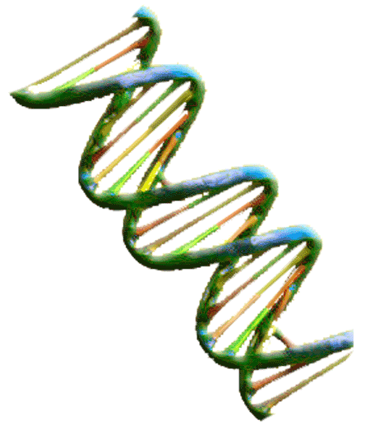
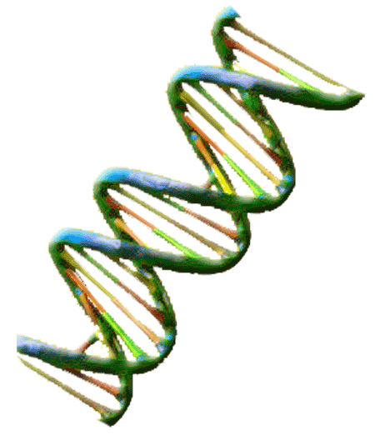
Bos Taurus Genetics
Exploring Current DNA Research of Longhorn Cattle

Slide 2
DNA Vocabulary
DNA - a double helix chain of nucleic acid in a cell that carries genetic and hereditary information
Chromosomes – a strand of DNA that carries genes in linear order. Cattle carry 30 pairs of Chromosomes
Gene- a unit of inheritable information arranged and located within chromosomes
Scatter Plot Graph- a graph that use horizontal and vertical axes to plot data points to show how much one variable is affected by another.
Correlation -The relationship between two variables
SNP –pronounced “snip” stands for single nucleotide polymorphism is a variance of DNA sequence usually representing two alleles
Eigenvector-measure the frequency of a snp of DNA on a scatter plot graph

Slide 3
Current Longhorn DNA Science
Scientist are currently genetically mapping DNA from Longhorns and other breeds of cattle. These studies rely on identifying genetic codes based on exclusion. This means that scientist identify what Longhorn DNA is by establishing what it is not. They use scatter plot graphs to determine how frequency of SNPs, segments of DNA structure , vary within a species and cluster to form breeds. Each genetic difference and relationship gives a clearer understanding of the genetic make up of individual breeds.

Slide 4
Current Genetic Research
Currently geneticists are studying longhorn DNA and comparing it to other breeds of cattle. The are attempting to form a blueprint that defines historically correct longhorns and separates them from other breeds of cattle. They are also attempting to sort out impurities in the breed. The graph below represents one of the ways that geneticist look at DNA analysis.

Slide 5
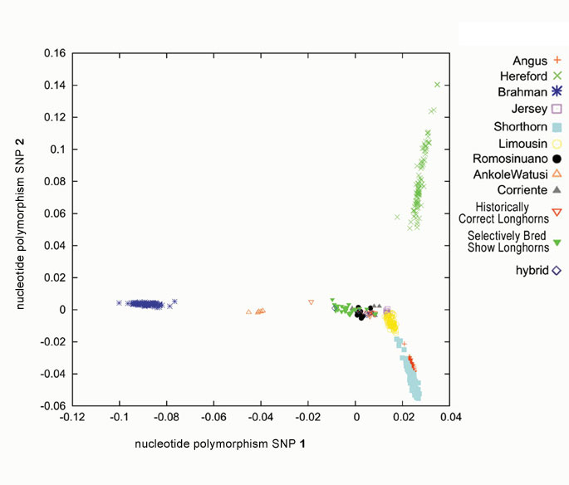
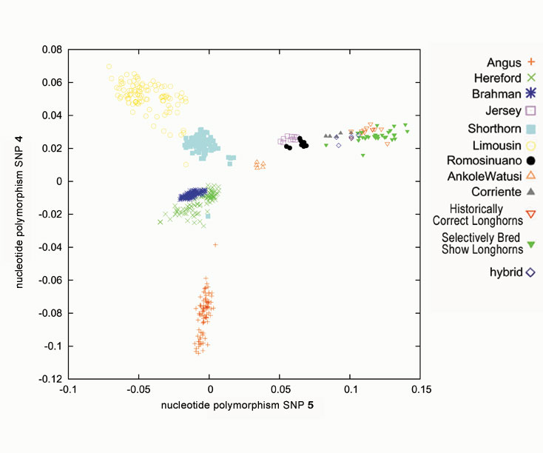
Plot Graph 1 Plot Graph 2
When preparing presentations of their findings they can use a scatter plot graph like the ones above. Each axis is labeled nucleotide polymorphism SNP which represents a segment of DNA containing genetic alleles.
Using both plot graphs compare the cattle represented. Which ones are have DNA most like the Historically Correct Longhorns and therefore need to be studied further? Which ones are clearly not similar to the longhorn in this segment of DNA?

Slide 6
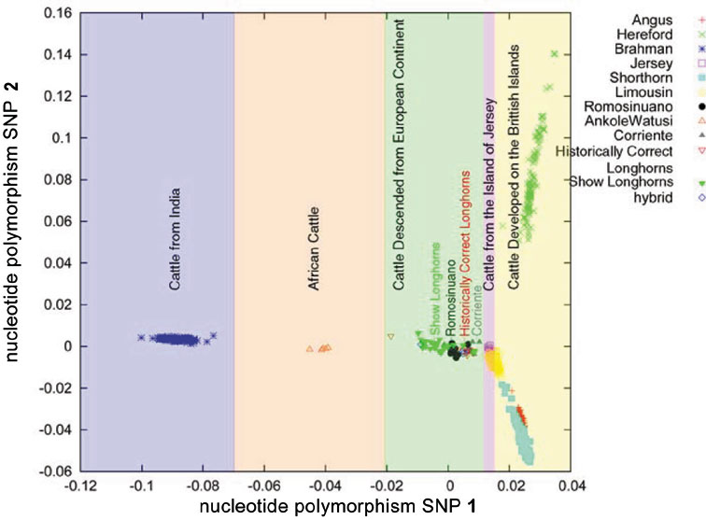
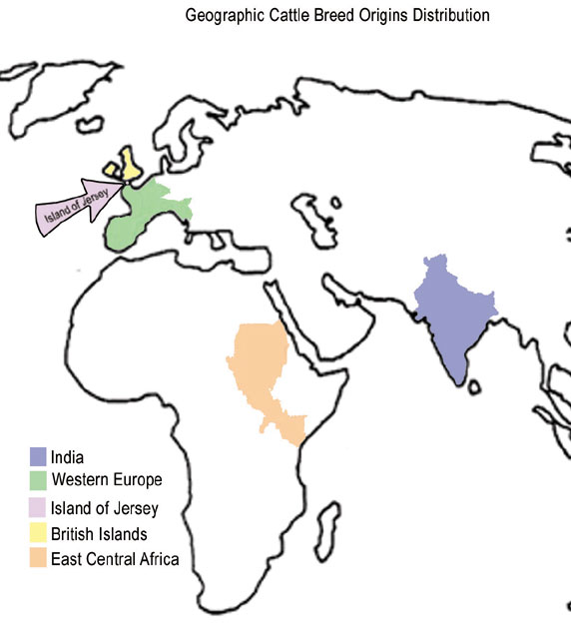
Geographic Influence
Look at the scatter plot graph above and the color coded map to the right. What influence do you think geography has had on cattle genetics? Be specific.

Slide 7
Geneticist study the longhorn for several reasons. Most colors and color patterns found in all cattle breeds occur in the longhorn. Unlike other domestic breeds of cattle longhorns developed through a process of natural selection in the 17th , 18th, and 19th centuries. Longhorn genetics are also studied to establish genetic markers that separate Longhorns as a breed.

Slide 8
TEKS
High School Biology 112.34. c
6) Science concepts. The student knows the mechanisms of genetics, including the role of nucleic acids and the principles of Mendelian Genetics. The student is expected to:
(A) identify components of DNA, and describe how information for specifying the traits of an organism is carried in the DNA;
(B) recognize that components that make up the genetic code are common to all organisms;
(D) recognize that gene expression is a regulated process;
(E) identify and illustrate changes in DNA and evaluate the significance of these changes;
(H) describe how techniques such as DNA fingerprinting, genetic modifications, and chromosomal analysis are used to study the genomes of organisms.
(7)Science concepts. The student knows evolutionary theory is a scientific explanation for the unity and diversity of life. The student is expected to:
(A) analyze and evaluate how evidence of common ancestry among groups is provided by the fossil record, biogeography, and homologies, including anatomical, molecular, and developmental;

Slide 9
Bibliography
Dr David M. Hillis, ”The Genetics of Coloration in Texas Longhorns” , Parts I-V , 2004, University of Texas, http://doublehelixranch.com/color.html
Dr. David Kirkpatrick, “Color Inheritance in Beef Cattle”, Animal Science, University of Tennesse, http://animalscience.ag.utk.edu/beef/pdf/ColorInheritenceFDK2004.pdf
This Power Point was developed by Kristene Newcomb for Cattlemen’s Texas Longhorn Conservancy and the State Herds of Texas. You are welcome to use it in your class room.
Kristene@folsomfallies.com

