Slide 1
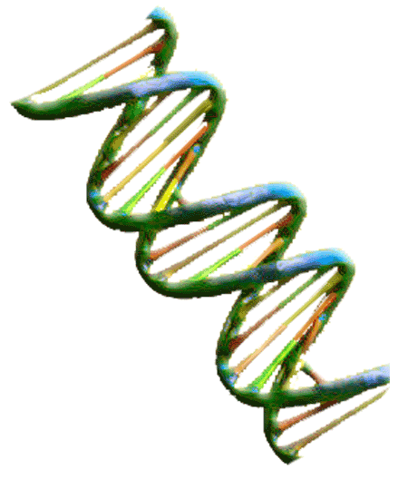
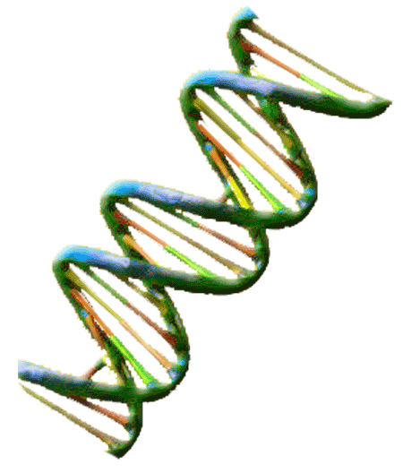
Bos Taurus Genetics
Exploring Genotypes and Phenotypes of Longhorn Cattle
Horns

Slide 2
Genetics Vocabulary
Phenotype – describes the physical appearance of a specific genetic trait or characteristic
Genotype – the genetic code consisting of a pair of alleles that describes a inheritable characteristic or trait
DNA - a double helix chain of nucleic acid in a cell that carries genetic and hereditary information
Gene- a unit of inheritable information arranged located within chromosomes
Allele – one member of a pair of genes that determines genetic characteristics
Heterozygous - a pair of alleles that contain two different alleles one of which is dominant
Homozygous – a pair of identical alleles
Dominant Trait – a trait that will appear in offspring if one allele is present . This trait will appear in both heterozygous and homozygous gene pairs.
Recessive Trait – a trait that will appear only if two copies of the allele are present. This trait only appears in homozygous gene pairs
Punnett Square – a square model of the allele genotypes used to predict the outcome of a genetic cross.

Slide 3
How Traits are Inherited
All cells contain DNA which is the “blueprint” that describes how an animal will look or act. DNA the genetic information which determines heredity. Genetics is the Science of ½’s. The genetic information for a specific trait is contained in a pair of genes called alleles. One half of the pair comes from each parent.
Sire
½
Dam
½
Offspring

Slide 4
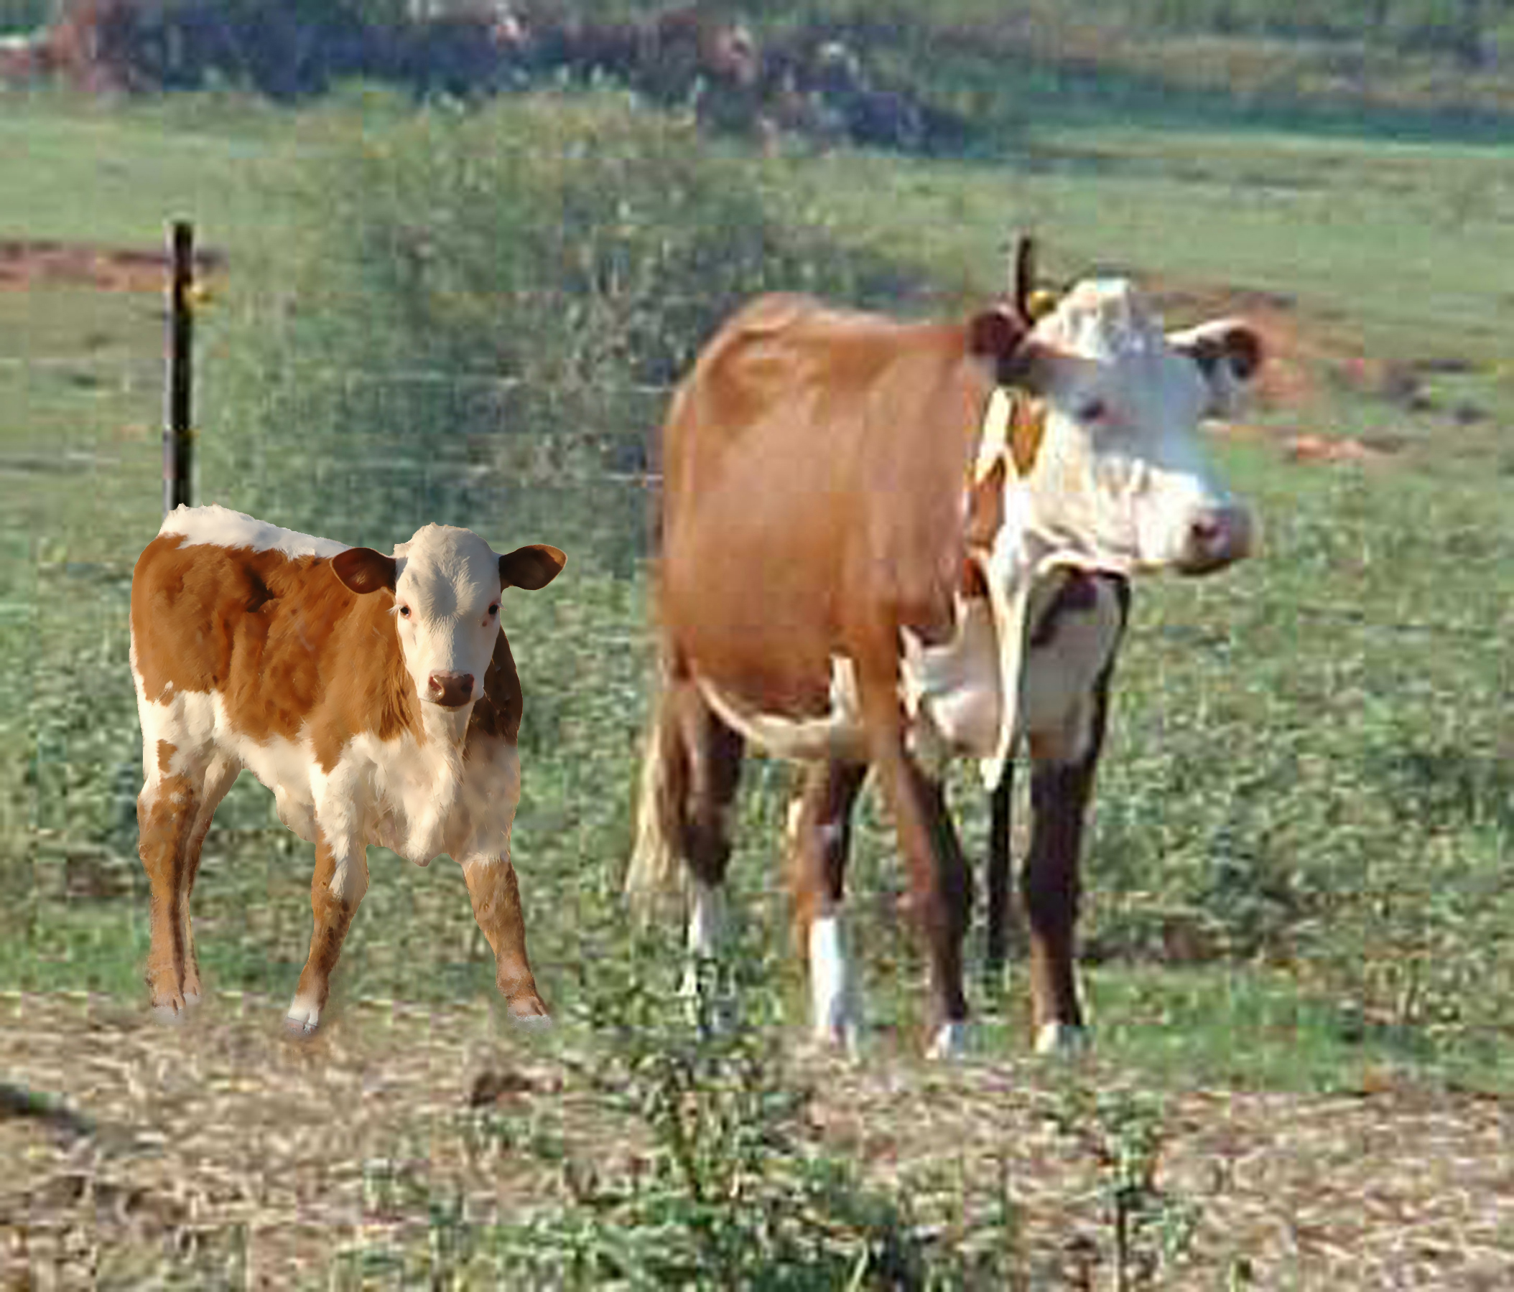
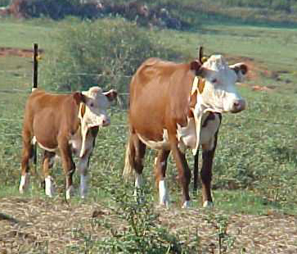
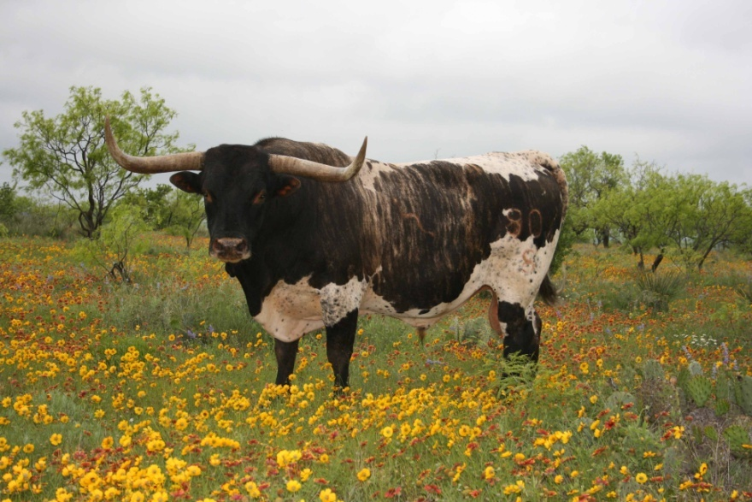
Horn Genetics
X
Sometimes beef ranchers cross longhorn bulls with their cows because longhorn calves are much smaller than beef calves. Smaller calves mean that less cows and calves die during the birthing process. However many beef ranchers don’t want horns in their herd.

Slide 5
Horn Genetics; Traits Controlled by a Single Pair of Genes
The alleles in a the gene pairs can be the same homozygous or different heterozygous.
When they are heterozygous one allele will be dominant and the other recessive.
The polled trait is described as HH. The horn allele is described as hh.
The polled allele, H, produces no horns, H is completely dominant over the recessive allele, h, that produces horns.
Any time the dominant H allele is present the animal will not have horns.

Slide 6
Genotype Results from Crossbreeding 1. Homozygous Cross
Polled Hereford Dam X Longhorn Sire
Offspring receives one allele from each parent.
The combination of these alleles makes up the genotype which determines the phenotype of each offspring.

Slide 7
Phenotype Results from Crossbreeding 1. Homozygous Cross
Polled Hereford Dam X Longhorn Sire
Results :
100% of the offspring’s genotype is heterozygous type Hh.
100 % of the offspring’s phenotype is polled, does not have horns.

Slide 8
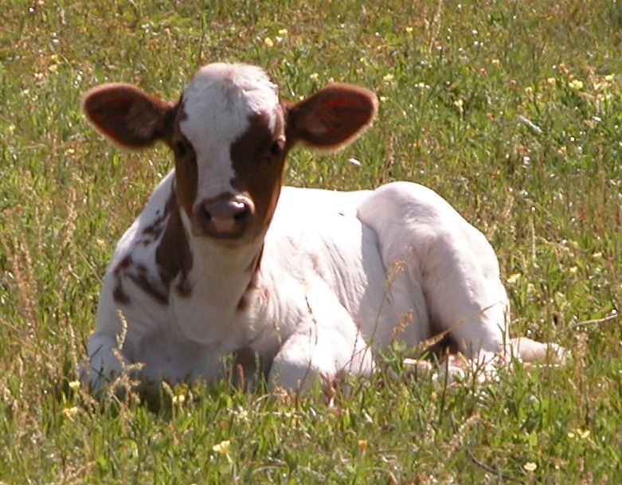
Horn Genetics; Heterozygous Crosses
We know that 100% of the offspring of a homozygous crosses will not have horns. What happens when we cross heterozygous crosses? Will any of the offspring have horns. Fill out the next Punnett Squares to predict the outcome of crossbreeding heterozygous cattle.

Slide 9
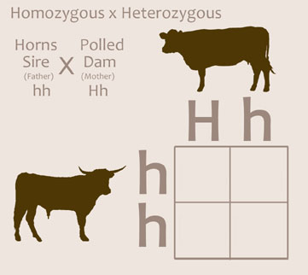
Horn Genetics
2. Heterozygous Cross
3. Heterozygous/ Homozygous Cross
What percentages of each genotypes resulted in this cross?
What percentage of each phenotypes resulted in this cross?
Were the phenotype and genotype results the same? Why or Why not?

Slide 10
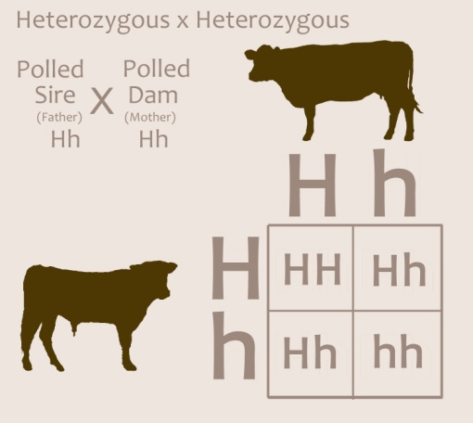
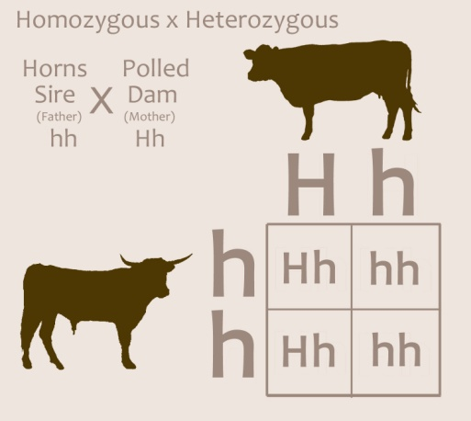
Heterozygous Crosses ; check your results
Homogeneous crosses result in 100% of the offspring having the same genotype and phenotype.
Heterozygous crosses have a variable result.
Genotypes:
HH - 25%
Hh - 50%
hh - 25%
Phenotypes :
Polled - 75%
Horns - 25%
Genotypes:
Hh - 50%
hh - 50%
Phenotypes :
Polled - 50%
Horns - 50%

Slide 11
4. The calf shown below will have horns. Based on what you just learned about horn genetics which two statements are true ?
A. Both of this calf’s parents had horns
B. This calf’s sire and dam both carry the recessive allele for horns.
C. The genotype represented by this calf is hh.
D. The genotype represented by this calf is either Hh or HH.

Slide 12
TEKS
Middle School Science, Grade 7 112.19.b
(14) Organisms and environments. The student knows that reproduction is a characteristic of living organisms and that the instructions for traits are governed in the genetic material. The student is expected to:
(A) define heredity as the passage of genetic instructions from one generation to the next generation;
(B) compare the results of uniform or diverse offspring from sexual reproduction or asexual reproduction; and
(C) recognize that inherited traits of individuals are governed in the genetic material found in the genes within chromosomes in the nucleus.

Slide 13
Bibliography
This Power Point was designed to be used with the
“Bos Taurus Horns Genetics” work sheet
Dr David M. Hillis, ”The Genetics of Coloration in Texas Longhorns” , Parts I-V , 2004, University of Texas, http://doublehelixranch.com/color.html
Dr. David Kirkpatrick, “Color Inheritance in Beef Cattle”, Animal Science, University of Tennesse, http://animalscience.ag.utk.edu/beef/pdf/ColorInheritenceFDK2004.pdf
This Power Point was developed by Kristene Newcomb for Cattlemen’s Texas Longhorn Conservancy and the State Herds of Texas. You are welcome to use it in your class room
Kristene@folsomfallies.com

